Slide 1
Global Disaster Life Support System (GDLSS)
Team : CIM Spectrum Big Data
Pankaj Khattar
Tapan Sharma
Parth Anand

Slide 2
Global Disaster Life Support System - Introduction
GDLSS is dedicated to the establishment and propagation of standardized, all-hazards, multi-disciplinary, and competency-based end to end system for responders in mass casualty situations.
GDLSS offers a series of steps to automate & integrate
emergency response
personnel, health care professionals
medical agencies, insurance agencies,
financial & government institutions for mass casualty disaster events
GDLSS is based on technologies involving
Artificial Intelligence, Machine Learning,
Internet of Things (IOT),
BlockChain,
Web & Mobile based Smart Applications

Slide 3

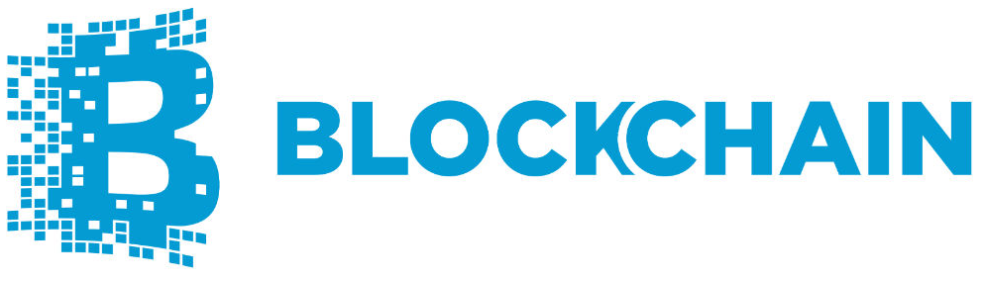
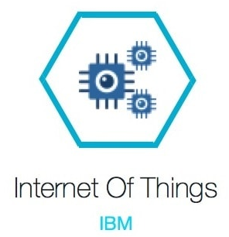
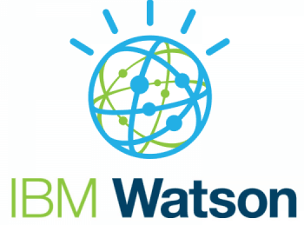


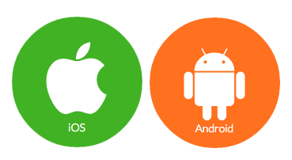






Global Disaster Life Support System - Ecosystem
Api’s
technology stack
GDLSS
personal & social

Slide 4
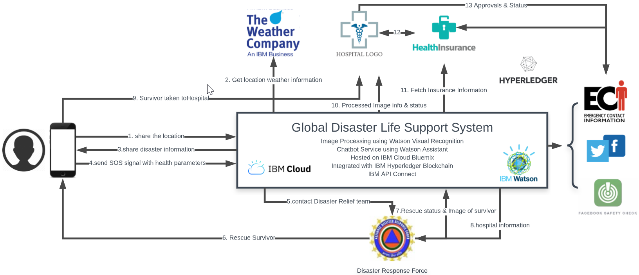
Global Disaster Life Support System - Flow

Slide 5
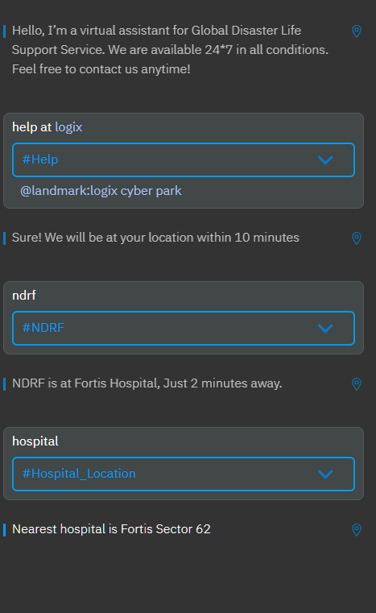

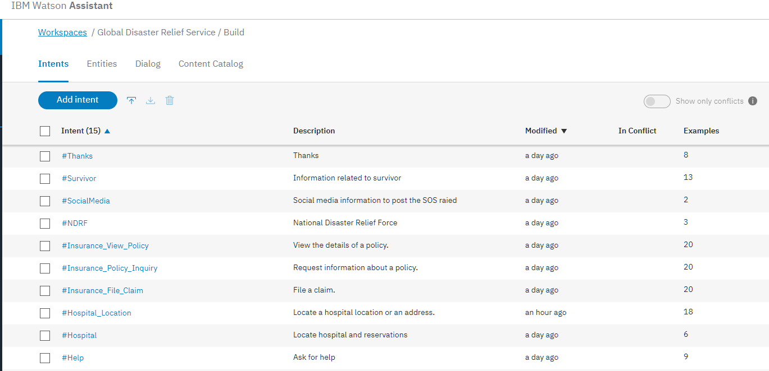
Demo GDLSS – Watson Assistant Service

Slide 6
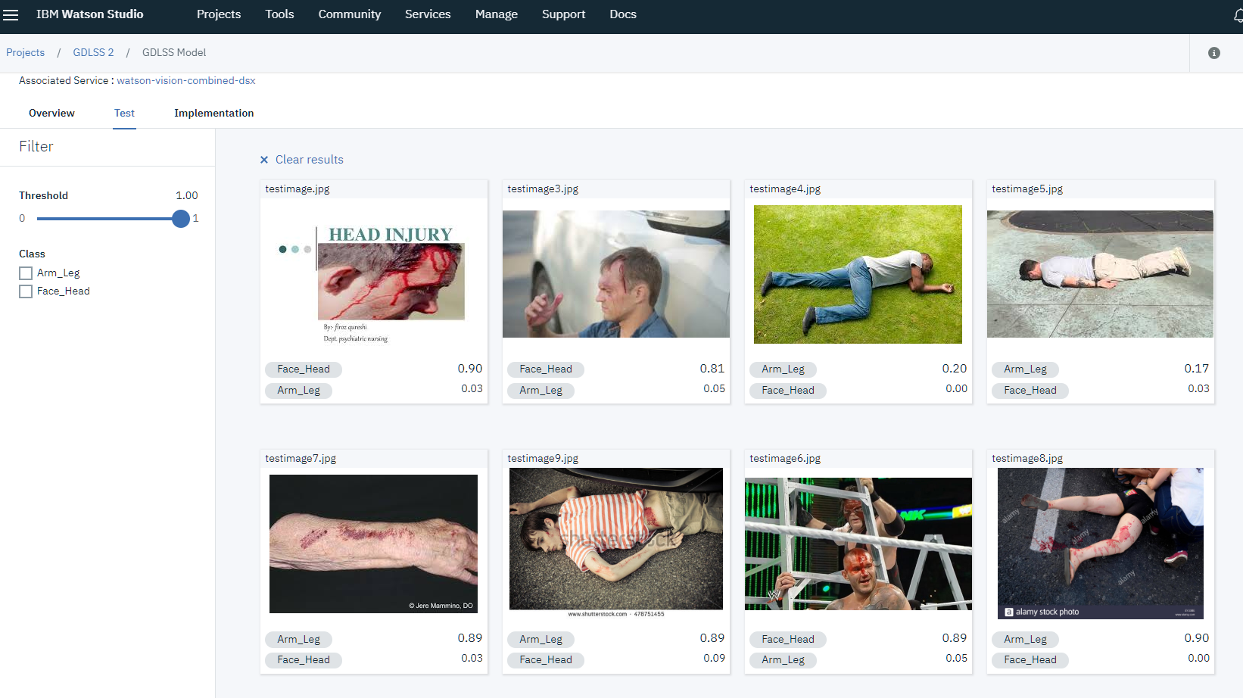
Demo GDLSS – Watson Visual Recognition App/Service

